Slide 1
AI Overview
Comprehensive Course Summary on Artificial Intelligence

Slide 2

Introduction
This presentation covers foundational concepts and practical applications of Artificial Intelligence. It integrates theory with lab exercises, highlighting key algorithms, agent models, and problem-solving methods explored throughout the AI course.

Slide 3
Definition and Scope of AI
Artificial Intelligence (AI) is the branch of computer science focused on creating systems capable of performing tasks that require human intelligence. It encompasses learning, reasoning, problem-solving, and understanding language to mimic cognitive functions.

Slide 4
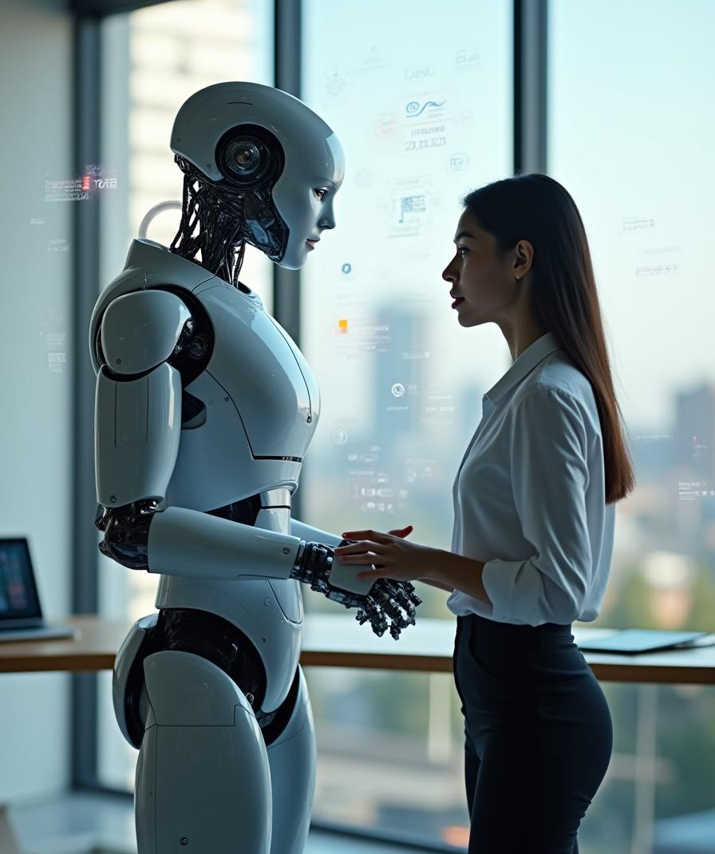
Goals of AI
The primary goals of AI include developing systems that can perceive, reason, act autonomously, and learn from experience. Objectives range from automating repetitive tasks to achieving human-level intelligence and enhancing decision-making processes.

Slide 5
Applications of AI
AI is applied in various fields such as healthcare, finance, robotics, and gaming. It enables innovations like smart assistants, autonomous vehicles, fraud detection, and efficient data analysis improving operational efficiency and user experiences.

Slide 6
Types of Agents and Their Goals
Agents in AI are entities that perceive their environment and act upon it. They vary from simple reflex agents responding to stimuli to learning agents that improve over time. Each agent’s goal is to maximize its performance measure based on its environment.

Slide 7

Types of Environments and Characteristics
AI environments can be fully or partially observable, deterministic or stochastic, and static or dynamic. Understanding these traits helps design appropriate agent behaviors suited for scenarios like single agent or multi-agent settings.

Slide 8
Rationality in Agents
Rationality in AI agents refers to taking actions that maximize the expected performance based on available knowledge. Rational agents aim to achieve the best outcome or optimize their goals given the environment’s constraints and uncertainties, ensuring effective decision-making in every situation.

Slide 9
State Space Search Methods
State space search involves exploring a set of possible states to find a path to the goal. Methods include breadth-first, depth-first, iterative deepening, and bidirectional search, each with unique efficiencies depending on problem characteristics and computational limits.

Slide 10
Heuristic Search Strategies
Heuristic search uses domain-specific knowledge to guide search processes more efficiently. Techniques like A search and best-first search rely on heuristics to estimate costs, significantly improving search speed and accuracy in complex problem spaces.

Slide 11
Key Algorithms: Minimax and Alpha-Beta Pruning
Minimax algorithm is central to two-player games, evaluating possible moves to optimize outcomes. Alpha-beta pruning enhances minimax by eliminating branches that won’t affect the final decision, substantially reducing computation time without affecting results.

Slide 12
AI in Game Development with GUI Implementations
AI algorithms like minimax and alpha-beta pruning are implemented in GUI-based games such as chess, tic-tac-toe, and number guessing. These interactive applications demonstrate AI’s ability to make intelligent decisions in dynamic environments, merging theory with practical lab work.

Slide 13
Conclusions
This course equips learners with a deep understanding of AI fundamentals, including intelligent agents, problem-solving, search strategies, and game algorithms. Integrating theoretical knowledge with hands-on lab implementations fosters comprehensive expertise, preparing students to develop practical AI solutions for diverse real-world challenges.

Slide 14
Thanks!
Please keep this slide for attribution

